Slide 1



DESAFIO DIO 3 atual
View in Power BI
Last data refresh:
21/08/2026 15:23:06 UTC
Downloaded at:
21/08/2026 15:30:26 UTC

Slide 2
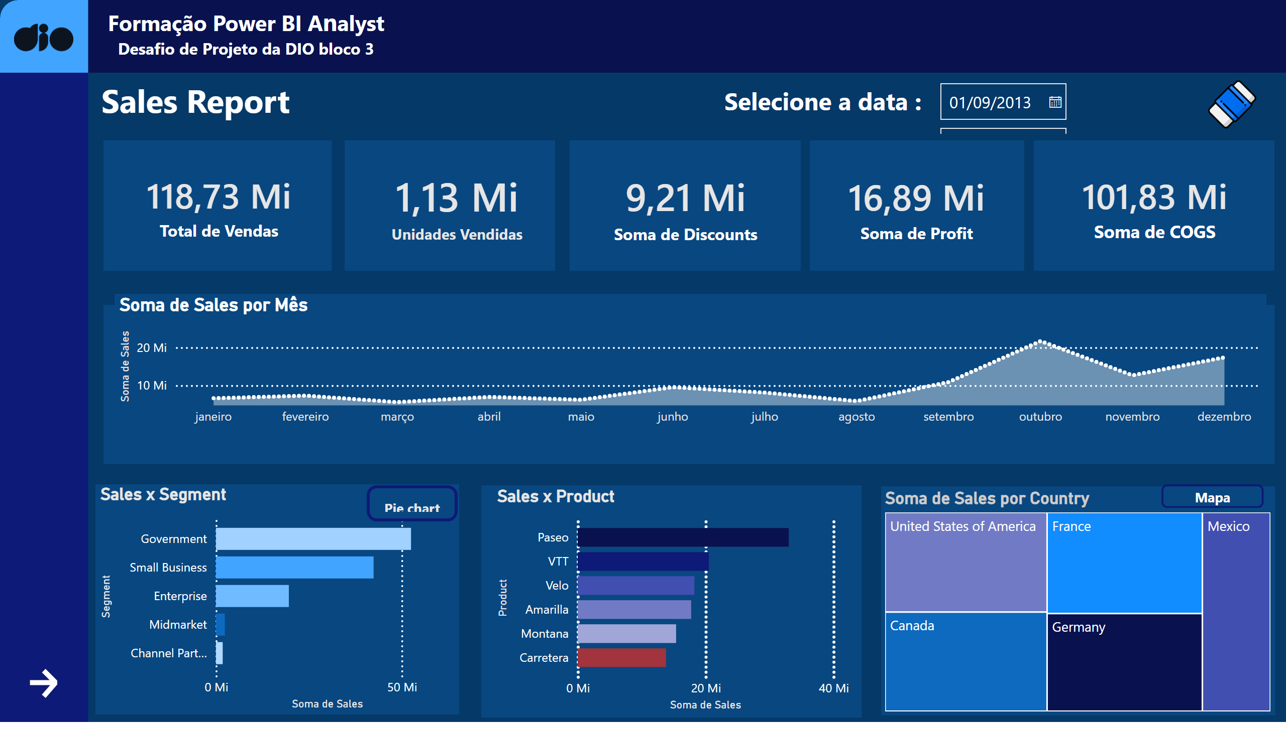
Página 1
Notes:
DATA
No alt text provided
shape
No alt text provided
BORRACHA
No alt text provided
shape
No alt text provided
donutChart
No alt text provided
shape
No alt text provided
shape
No alt text provided
textbox
No alt text provided
cardVisual
No alt text provided
image
No alt text provided
actionButton
No alt text provided
pie chart
No alt text provided
shape
No alt text provided
Sales x Segment
No alt text provided
cardVisual
No alt text provided
treemap
No alt text provided
cardVisual
No alt text provided
shape
No alt text provided
Botão mapa
No alt text provided
cardVisual
No alt text provided
cardVisual
No alt text provided
slicer
No alt text provided
shape
No alt text provided
shape
No alt text provided
map
No alt text provided
actionButton
No alt text provided
shape
No alt text provided
textbox
No alt text provided
shape
No alt text provided
shape
No alt text provided
actionButton
No alt text provided
shape
No alt text provided
GRAFICO LINHA
No alt text provided
Sales x Product
No alt text provided
actionButton
No alt text provided
areaChart
No alt text provided

Slide 3
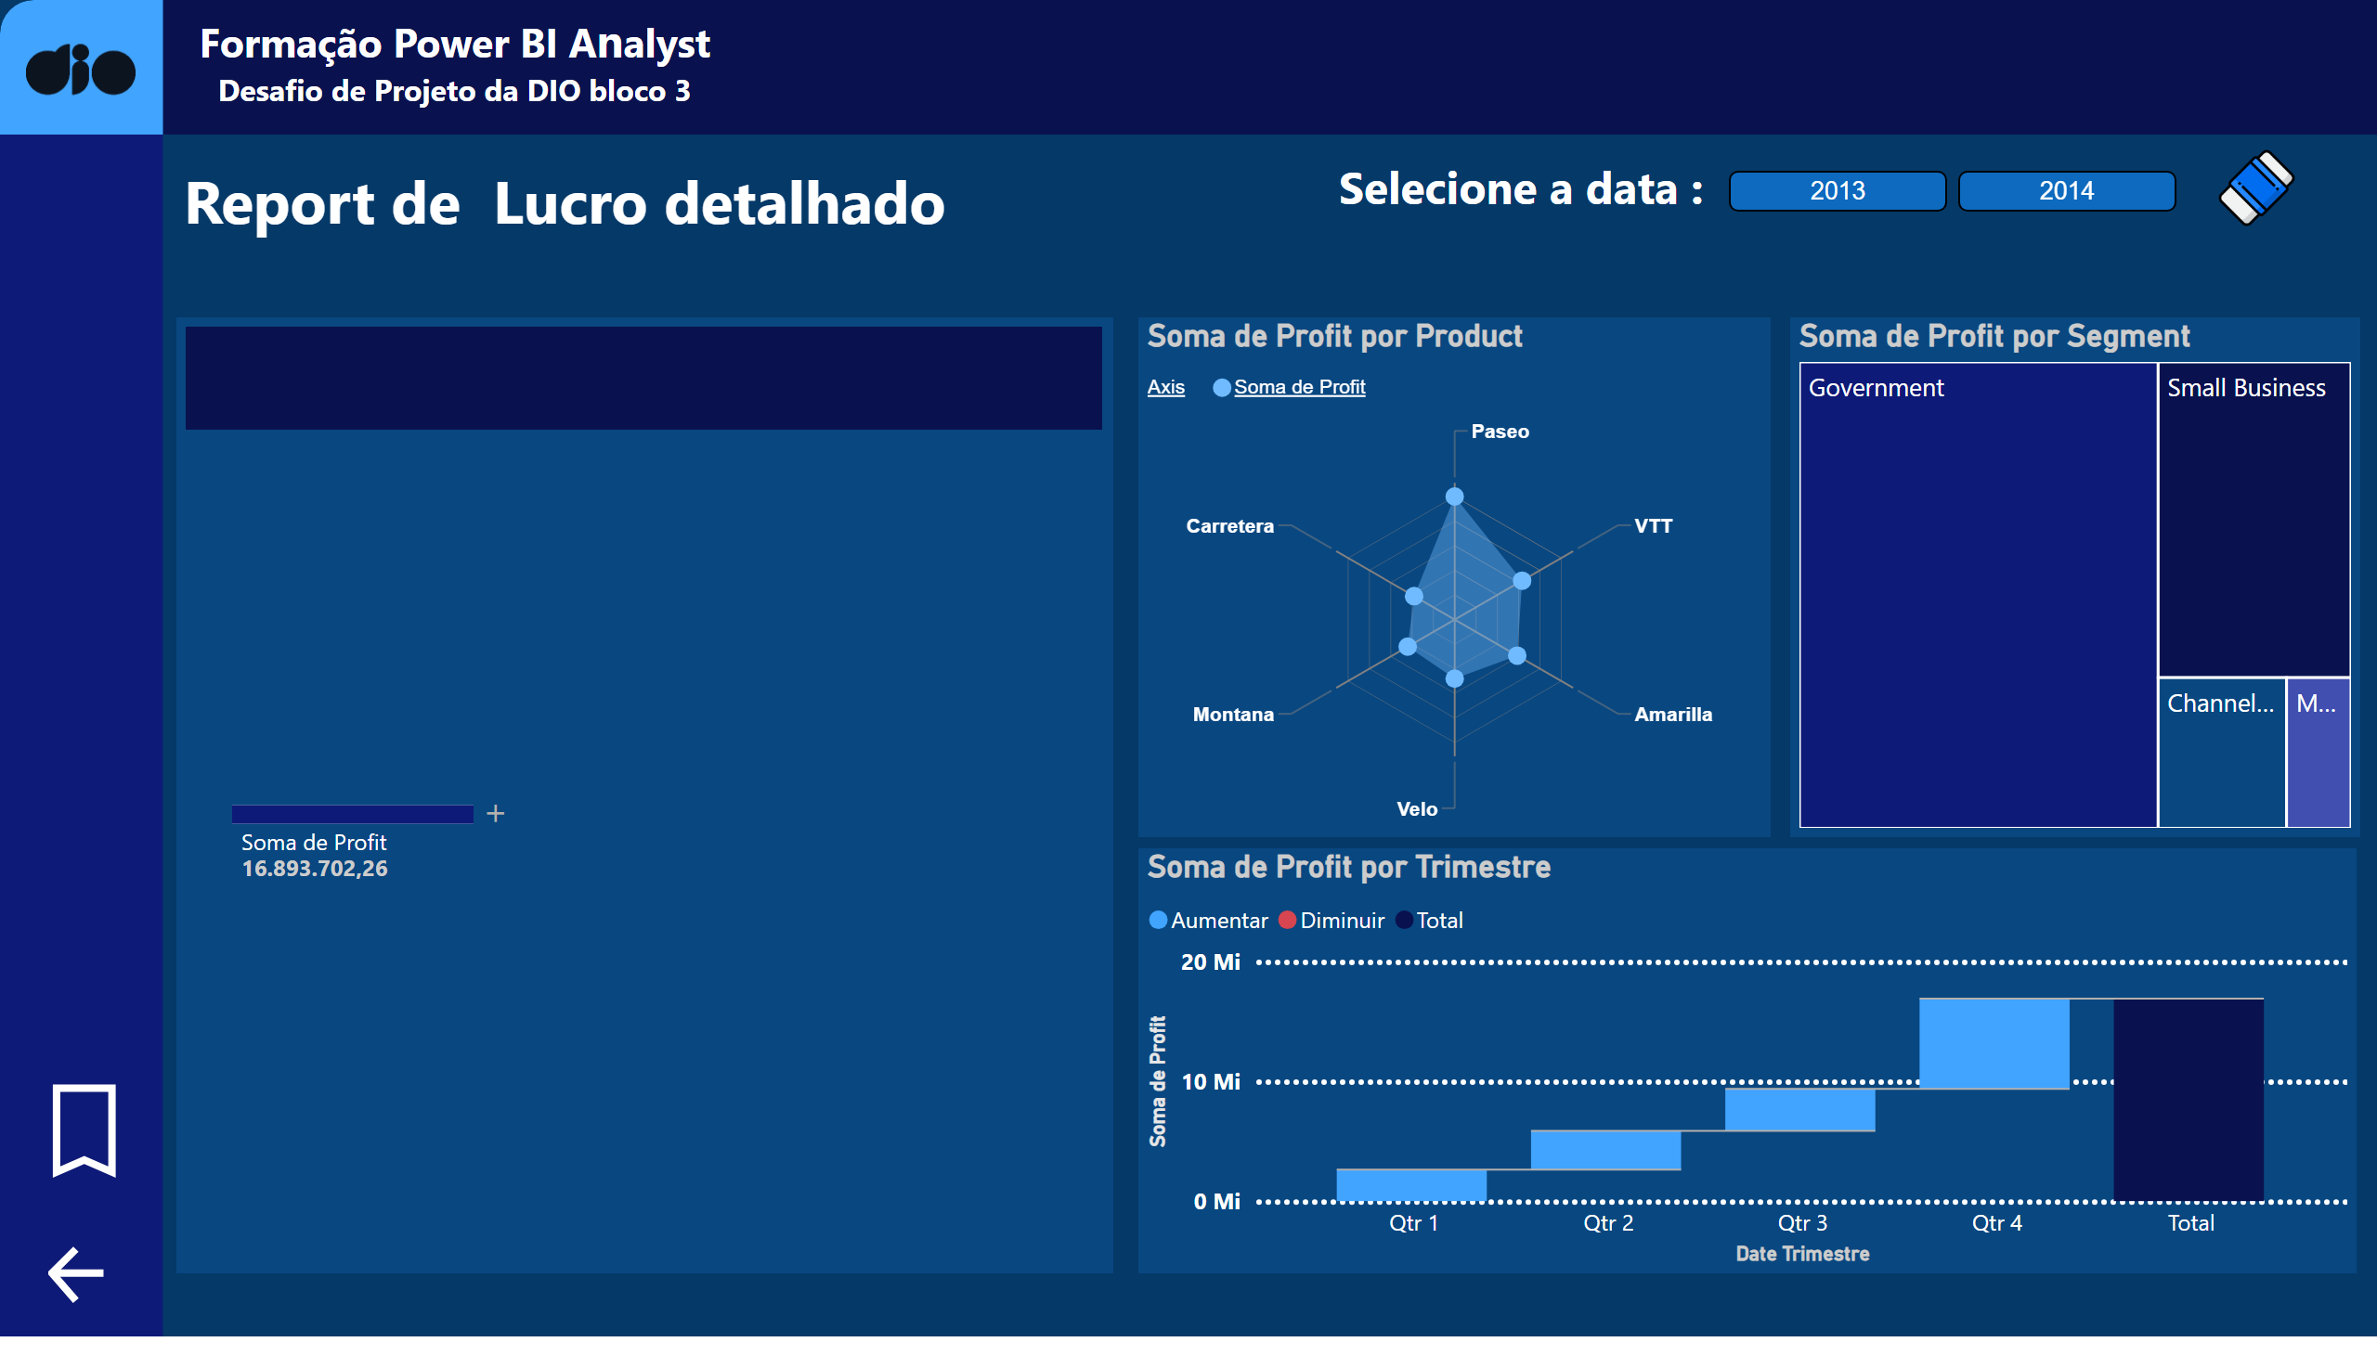
Página 2
Notes:
map
No alt text provided
shape
No alt text provided
actionButton
No alt text provided
treemap
No alt text provided
waterfallChart
No alt text provided
textbox
No alt text provided
actionButton
No alt text provided
DATA
No alt text provided
shape
No alt text provided
textbox
No alt text provided
shape
No alt text provided
actionButton
No alt text provided
shape
No alt text provided
Botão página 2 limpar
No alt text provided
ChicletSlicer1448559807354
No alt text provided
decompositionTreeVisual
No alt text provided
actionButton
No alt text provided
shape
No alt text provided
image
No alt text provided
GRAFICO LINHA
No alt text provided
image
No alt text provided
shape
No alt text provided
shape
No alt text provided
shape
No alt text provided
RadarChart1446119667547
No alt text provided

